Slide 1
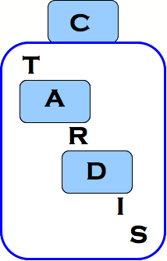


Triple Antiplatelets for Reducing Dependency after Ischaemic Stroke
TARDIS Trial
Training for New Investigators
2014 Protocol V1.5
Notes:
1

Slide 2


TRIAL STATUS
Start up phase:
  Funded by BHF.
  Over 3 years, 902 patients were recruited from centres within the UKSRN
Main Phase:
  Funded by HTA
  Commenced 1/10/12
  Total recruitment target 4100 by 30/04/17
  Current recruitment: 2753 as 28/8/15
Sponsor: University of Nottingham
Adoption: Stroke Research Network
www.tardistrial.org

Slide 3
Definitions
Stroke - WHO
  A clinical syndrome characterised by rapidly developing clinical symptoms and/or signs of focal (and at times global) loss of cerebral function with symptoms lasting for more than 24 hours or leading to death, with no apparent cause other than that of vascular origin
  Brain imaging required before trial entry
  (See flowchart as patients should be randomised as early as possible and preferably within the first 24hrs)
TIA
  A sudden focal neurological deficit of the brain or eye, presumed to be of vascular origin and lasts less than 24 hours
  Brain imaging is not required before trial entry
www.tardistrial.org

Slide 4
TARDIS: Primary objective
To assess stroke severity at 90 days after short -term administration (28 or 30 days) of
  Intensive antiplatelet therapy (aspirin + clopidogrel + dipyridamole)
VERSUS
either aspirin + dipyridamole or clopidogrel monotherapy
in patients with very recent ischaemic stroke or TIA
www.tardistrial.org

Slide 5
TARDIS IMPs – Aspirin
Dose: Loading dose 150-300mg on day of randomisation (Day 0), then 50-100 mg per day from Day 1 for 28/30 days
  If recruit already taken 75mg the same morning, then give loading dose of 225mg, if already given 300mg then no need to give again the same day.
  Aspirin may be given in combination with dipyridamole as Asasantin
  Route:
  Enteral (including via nasogastric tube – dispersible or crushed tablets can be used).
  Rectal: 150mg suppository alternate days can be used as an alternative if necessary
  A protocol violation will occur if 300mg aspirin is continued beyond the loading dose.
www.tardistrial.org

Slide 6
TARDIS IMPs – Dipyridamole
Dose: 225mg to 450 mg daily, including 200mg modified release (MR) twice daily for 28/30 days
  commences the day of randomisation – if randomised in the afternoon, recruit only takes one dose that day and starts twice a day on Day 1
  Fixed combinations of A and D may be used
  e.g. Asasantin Retard (aspirin 25mg, dipyridamole 200mg MR bd)
  Route:
  Enteral (including via nasogastric tube). Dysphagic patients with
  enteral access will take dipyridamole suspension, dispersed capsules or crushed dipyridamole tablets 100mg four times daily.
www.tardistrial.org

Slide 7
TARDIS IMPs – Dipyridamole
Patients with a headache from dipyridamole will have the dose weaned up from daily MR 200mg or standard release 50 mg once daily to MR 200mg twice daily
PLEASE DO NOT STOP THIS DRUG IMMEDIATELY
without trying other options:
  The dose could be dropped to daily MR 200mg, or standard release 75mg od and then slowly increased to MR 200mg bd, OR a dose tolerated by the recruit
  If it is already known at the recruitment stage that this patient cannot take dipyridamole due to side effects then they are ineligible.
www.tardistrial.org

Slide 8
TARDIS IMPs – Clopidogrel
Dose: Loading dose 300mg (4 x 75mg) on day of randomisation (Day 0), then 75mg od for 28/30 days
  If recruit already taken 75mg the same morning, then give loading dose of 225mg, if already given 300mg then no need to give again the same day.
  Route:
  Enteral (including via nasogastric tube – crushed tablets can be used)
  Since clopidogrel has come off patent, some packs may come in 28 rather than 30 tablets
www.tardistrial.org

Slide 9
Randomisation choices
Randomisation choices entered online:
  ACD vs C vs AD (A or C or D before rand, not all 3)
  ACD vs C (A or C only before rand no D)
  ACD vs AD (A or D only before rand no C)
  Can be different choice for TIA and Stroke
  48 hour delay
www.tardistrial.org

Slide 10
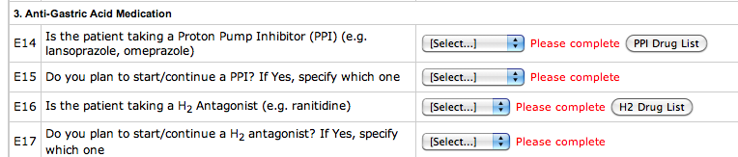
Gastro Protection
GI prophylaxis - PPI / H2 antagonist
After 30 days, the antiplatelet choice is up to the treating team, such as C as recommended by NICE
EMA recommendations discourage the use of omeprazole and esomeprazole with Clopidogrel
www.tardistrial.org

Slide 11
TARDIS: Inclusion criteria
Adults (50 or over) at high risk of recurrent ischaemic stroke,
within 48hrs of onset (24-48 if thrombolysed):
TIA:
Limb weakness and/or dysphasia lasting between 10 mins and
<24hrs with no residual symptoms and presenting with any
of the following:
      crescendo TIA (>1 TIA within 1 week)
      with an ABCD2 score >4
      admitted on dual antiplatelet therapy (aspirin+dipyridamole)
      Positive neuroimaging evidence (MRI) to support the new event.
Neuroimaging not necessary prior to randomisation.
Crescendo TIA is >1 TIA in one week and the onset time of last TIA is
taken as time of ictus.
www.tardistrial.org

Slide 12
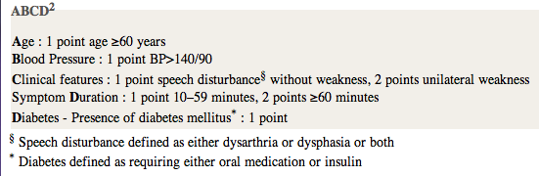
ABCD² score
If participant is not taking medication to control their diabetes they are not given a point for the trial
www.tardistrial.org

Slide 13
TARDIS: Inclusion criteria
STROKE:
Acute non-cardioembolic ischaemic stroke presenting with any of the
following:
  a. Ongoing limb weakness of more than one hour duration; and/or
  b. Ongoing dysphasia of more than one hour duration: and/or
  c. Resolved limb weakness of more than one hour duration with
  ongoing facial weakness; and/or
  d. Ongoing isolated hemianopia of more than 1 hour duration with
  positive neuroimaging evidence to support the new event (e.g.
  ischaemic stroke in the occipital lobe) and/or
  e. Limb weakness that resolves between 24-48hrs after onset
  f. Dysphasia that resolves between 24-48hrs after onset.
  g. Positive neuroimaging to support the new ischaemic event with MR
  diffusion.
  h. Already on combined dual antiplatelet therapy (aspirin + dipyridamole)
www.tardistrial.org

Slide 14
TARDIS: Additional inclusion information
  STROKE (continued..)
  Patients on combined therapy (aspirin + dipyridamole) or on monotherapy) eg aspirin alone, or clopidogrel alone, or dipyridamole alone, are eligible for recruitment.
  Neuroimaging is essential for ischaemic stroke to exclude intracranial haemorrhage and a non stroke diagnosis. If the patient received thrombolysis, a post-thrombolysis/pre-TARDIS scan needs to be done to exclude new thrombolysis associated bleeding prior to enrolment. Typically this is done routinely as ‘standard of care’, but if it is not done, then it must be done prior to enrolment.
  Patients, if thrombolysed for stroke with full recovery in less than 24 hours from the onset of symptoms, are eligible for inclusion as a stroke providing neuroimaging post thrombolysis excludes intracranial haemorrhage.
www.tardistrial.org

Slide 15
TARDIS: Exclusion criteria
1. Age<50
2. Isolated sensory symptoms or vertigo/dizziness or facial weakness
3. Isolated hemianopia without positive neuroimaging evidence
4. Intracranial haemorrhage
5. Baseline neuroimaging showing parenchymal haemorrhagic transformation (PHI/II) of infarct, subarachnoid haemorrhage or other non ischaemic cause for symptoms
6. Presumed cardioembolic stroke (e.g. history or current AF, myocardial infarction within 3 months)
7. Participants with contraindications to, or intolerance of, aspirin, clopidogrel or dipyridamole.
8. Participants with definite need for treatment with aspirin, clopidogrel or dipyridamole individually or in combination (e.g. aspirin and clopidogrel for recent MI/acute coronary syndrome)

Slide 16
TARDIS: Exclusion criteria
9. Definite need for full dose oral (e.g. warfarin, dabigatran) or medium to high dose parenteral (e.g. heparin) anti-coagulation. NB Low dose heparin for DVT prophylaxis is allowed
10. Definite need for glycoprotein IIb-IIIa inhibitors
11. Patients who have received thrombolysis within 24 hours
12. No enteral access
13. Pre-morbid dependency (mRS>2).
14. Severe high BP (BP>185/110 mmHg).
15. Haemoglobin less than 10g/dL
16. Platelet count more than 600 x 109 /L or less than 100 x 109 /L
17. White cell count more than 30 x 109 /L or less than 3.5 x 109 /L
18. Major bleeding within 1 year (e.g. peptic ulcer, intracerebral haemorrhage).
19. Planned surgery during 3 month follow-up (e.g. carotid endarterectomy)

Slide 17
TARDIS: Exclusion criteria
20. Concomitant STEMI or NSTEMI.
21. Stroke secondary to a procedure (e.g. carotid or coronary intervention)
22. Coma (GCS<8)
23. Non-stroke life expectancy<6 months
24. Dementia
25. Participation in another drug or devices trial concurrently or within 30 days.(participants may take part in observational studies or non-drug or devices trials)
26. Geographical or other factors that may interfere with follow-up e.g. no fixed address or telephone contact number, not registered with a GP, or overseas visitor.
27. Females of childbearing potential, pregnancy or breastfeeding
28. Patients who have not had post thrombolysis neuroimaging.
29. Patients on aspirin and clopidogrel prior to the underlying event.

Slide 18
Documentation
IMPORTANT
Please FAX the following documents
to the
Stroke Trials Office
Within 7 days of consent
0115 8231771
Consent form/s
Patient details form
Drug chart (load.dose)
CT/MR reports
Carotid assessment report
www.tardistrial.org

Slide 19
TARDIS TRIAL - data collection
Web-based trial
Case Report Forms (CRFs)
  available on http://www.tardistrial.org/jevpybki.htm
  recruit data can be entered directly onto live site (print and file report for audit)
CT/MR scans must be uploaded to website
  No unencrypted CDs accepted through the post
www.tardistrial.org

Slide 20
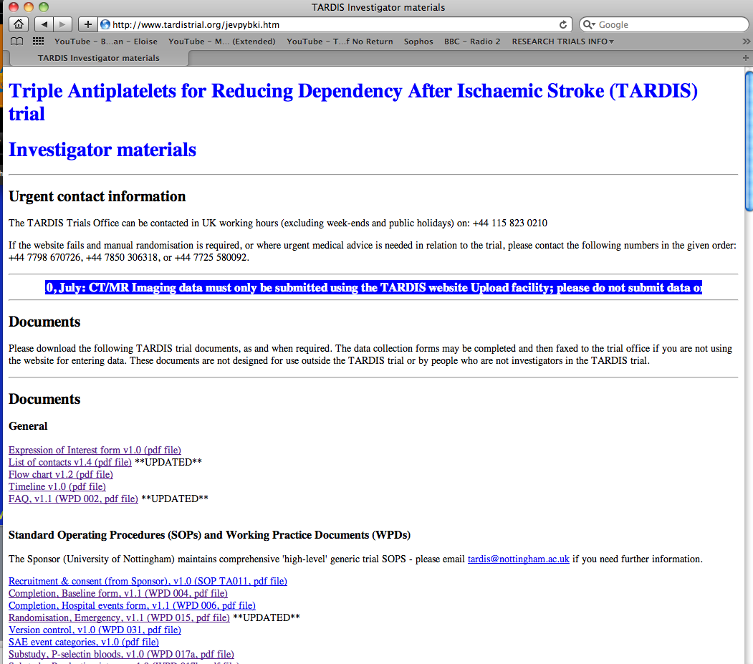
TARDIS Web-site: www.tardistrial.org
Documents link: http://www.tardistrial.org/jevpybki.htm
www.tardistrial.org

Slide 21
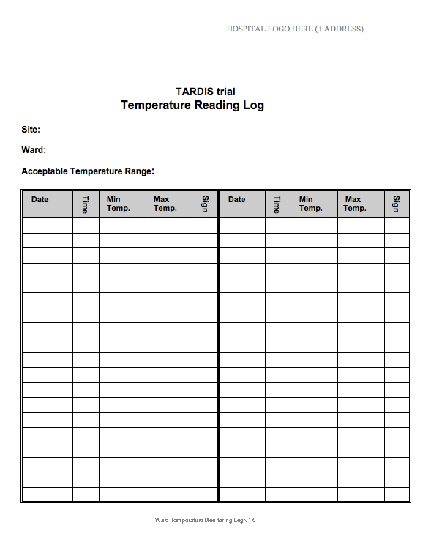
TARDIS IMP DOCUMENTATION –
Temperature monitoring log
If pharmacy dispense a stock of either the loading dose and/or 28/30 day supply of IMP to the ward/clinic, then a temperature log needs to be maintained for this stock (which should be kept separate to usual ward stock).
Temperature specification is highlighted in each of the individual IMP SmPC.
Check with your pharmacy dept as the supplier may differ from site to site.
www.tardistrial.org

Slide 22
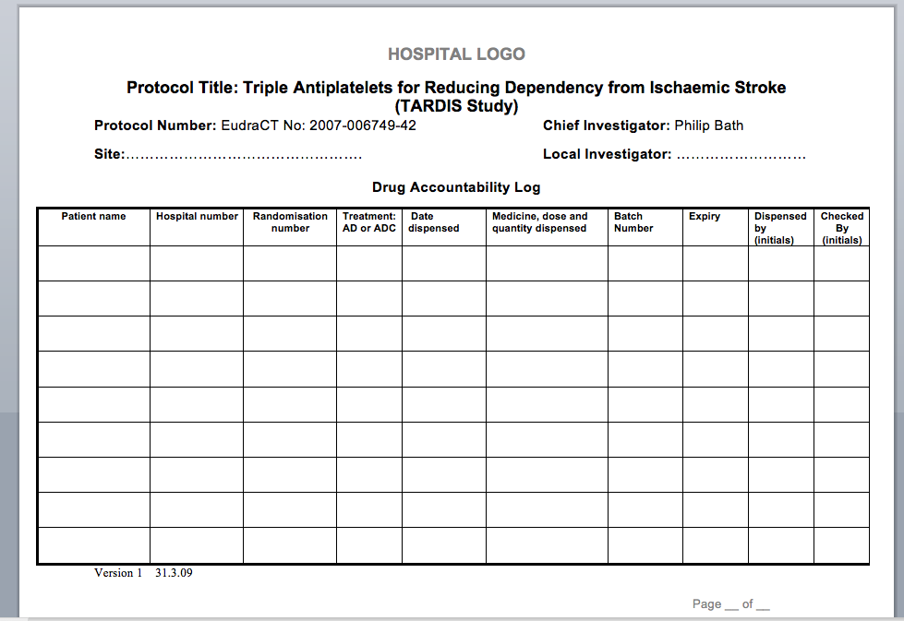
TARDIS IMP DOCUMENTATION –
Drug accountability log
www.tardistrial.org

Slide 23
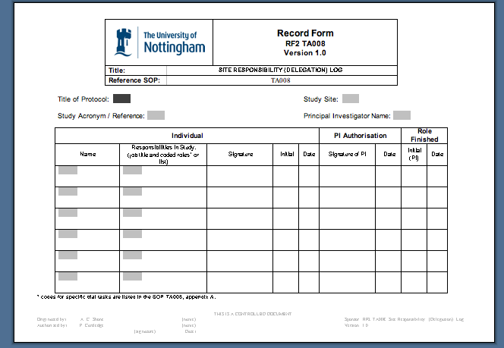
TARDIS – Delegation log
Hospital + Centre No
PRINCIPAL INVESTIGATOR REQUIRED ON EVERY PAGE
See Appendix A for responsibilities
www.tardistrial.org

Slide 24
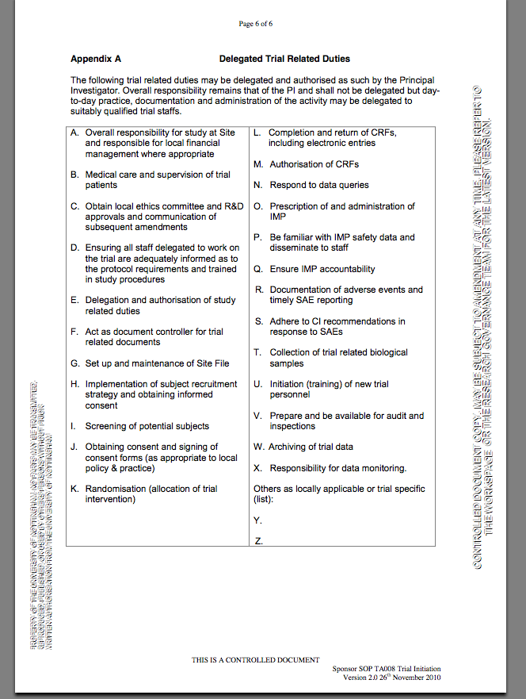
Appendix A
Delegated trial related duties
www.tardistrial.org

Slide 25
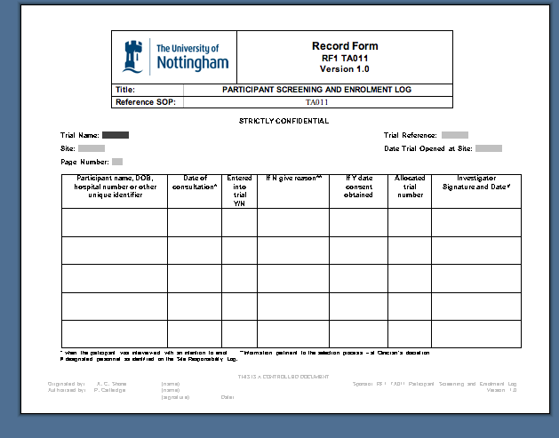
Screening log
Whole line Needs
completing and signing by investigator
Keep in Investigator Site file for auditing/monitoring
www.tardistrial.org

Slide 26
TARDIS: Blood Samples
FBC
  Baseline, Day 7, Day 35 & any clinical
  Safety of patient
  Mandatory
  Analysed at recruiting site’s lab.
Genetics blood test sample
  4mls EDTA. Frozen whole (i.e. no centrifugation)
  anytime from baseline to Day 35
Baseline
  4mls EDTA. Centrifuge to collect and freeze plasma.
  6mls clotted sample. Centrifuge to collect and freeze serum
Day 7±1:
  4mls EDTA. Centrifuge to collect and freeze plasma.
  6mls clotted sample. Centrifuge to collect and freeze serum
www.tardistrial.org

Slide 27
TARDIS:
Additional blood samples
  P-Selectin
    Aspirin / clopidogrel resistance (post to Nottingham)
www.tardistrial.org

Slide 28
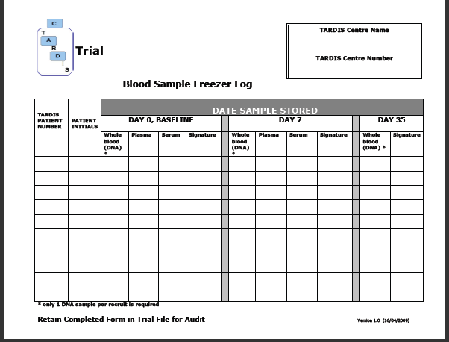
Blood sample freezer log
www.tardistrial.org

Slide 29
**** Important note ****
After Randomisation
Take the trial bloods prior to giving the loading doses, then
Give loading doses of aspirin, dipyridamole and/or clopidogrel (where appropirate) as soon as possible – on the same day as randomisation
www.tardistrial.org

Slide 30
Case Report Forms (CRF’s)
Data entry
Randomisation form
Baseline
Day 7
Day 35
Hospital Events (all recruits)
Outcomes/Serious Adverse Events
FBC
Additional Clinical Brain Imaging
Day 90 (Nottingham use only)
www.tardistrial.org

Slide 31
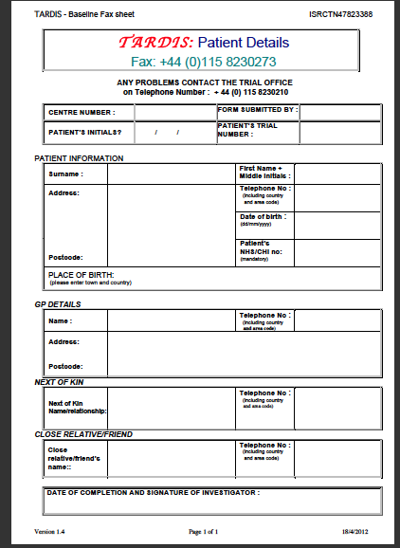
Patient details
Patient identifiable information faxed to Nottingham Co-ordinating Centre to enable 90 day follow-ups.
Kept separate from patient data (ISF, other file)
www.tardistrial.org

Slide 32
Consent forms
Must be signed by both parties at the same time INITIALS in boxes - not ticks
Same version of consent form as Information Sheets, and latest approved version
Consented only by staff(medics) on delegation log
GP letters (dated)
  Master GP / copy recruit file / copy hospital notes
Copies of consent form AND information sheet
  Master – Investigator Site File
  Copy medical/hospital notes
  Copy recruit/relative
  Copy coordinating centre (consent only)
www.tardistrial.org

Slide 33
Key points
Research and ward nurses are key to finding eligible recruits. However:
Only doctors on the delegation log can take consent for both Main and DNA consent
Doctors on delegation log need to prescribe allocated treatment
Research staff will perform Baseline, day 7, day 35, SAE/outcomes and discharge assessments/paperwork
Only staff authorised on the delegation log are allowed to work on the trial (Nottingham Coordinating Centre will approve these staff after receiving an up-to-date, signed CV and GCP certificate)
www.tardistrial.org

Slide 34
Other Paper Forms
Fax cover sheet
Screening and enrollment log
Delegation log
Blood sample Freezer log
Accountability log for all antiplatelets
Data correction form
Training record form
www.tardistrial.org

Slide 35
TARDIS SAEs and Outcomes
Outcome Events (including any bleeding event) and SAEs are collected from randomisation until completion of the 90 day follow-up.
  TIA
  Stroke
  MI - NSTEMI, STEMI
  Unstable angina
  PVD / Ischaemic limb
  Bleeding - minor, moderate, major
  Death
  AEs will not be collected as all three drugs are licensed and considerable information is known about them.
www.tardistrial.org

Slide 36
TARDIS: Definition of SAEs
To be reported within 48 hrs of known occurrence
Any untoward medical occurrence that?
  Results in death
  Is life-threatening
  Requires inpatient hospitalisation or prolongation of existing hospitalisation
  Results in persistent or significant disability/incapacity
  Is a congenital anomaly/birth defect
  Is medically important
www.tardistrial.org

Slide 37
TARDIS: Bleeding definitions
Major bleed: All major bleeds will constitute an SAE.
  FATAL bleeding.
  Symptomatic bleeding in a CRITICAL AREA or organ, such as intracranial, intraspinal, intraocular, retroperitoneal, intraarticular or pericardial, or intramuscular with compartment syndrome.
  Bleeding causing FALL IN HAEMOGLOBIN OF 2 g/L (1.24 mmol/l) or more, or leading to TRANSFUSION of 2 or more units of whole blood or red cells.
Moderate bleed: Moderate bleeds may or may not constitute an SAE depending on other criteria as determined by the investigator.
  Not major, and
  Bleeding causing FALL IN HAEMOGLOBIN OF >1 and < THAN 2 g/L (1.24 mmol/l), and no transfusion, or transfusion of 1 unit of whole blood or red cells.
Mild bleed: Mild bleeds do not constitute a serious adverse event but do constitute and outcome event.
  Not major or moderate, fall in haemoglobin of ≤1g/l, and
  Comprising bruising, gingival bleed or similar other type bleeding.
www.tardistrial.org

Slide 38
TARDIS SAEs and Outcomes
PIs must sign off all SAE/Outcomes entered online, by signing the paper copies and saving these in the Investigator Site File. (If these are subsequently updated, PI needs to re-sign the updated forms)
Sites will be expected to look through hospital systems to find out whether recruit has been hospitalised, had any SAEs and/or any OUTCOME events between Day 35 and Day 90 which need reporting.
Ask recruit at start of trial (or relative) to ring if any problems.
Remember – ALL bleeds of any description (minor, moderate, severe) must be reported.
www.tardistrial.org

Slide 39
Withdrawals
For accurate completion of the trial, we need to be able to collect follow-up details at Day 90 telephone call
If a recruit decides to withdraw then you will need to determine what exactly they are withdrawing from:
  Treatment?
  Day 7 &/or Day 35 follow up?
  Day 90 follow up?
  Contact with GP to gather life status
If the participant discontinues any antiplatelet medication for whatever reason, they still remain in the study until day 90
However, any participant is free to withdraw from the trial at any time and without giving reason.
www.tardistrial.org

Slide 40
Avoiding loss to follow-up…
  Adequate information given to participant at time of consent – in writing or verbally
  Ensure full and correct patient contact details taken, with alternative contact details and correct GP. Please collect at least 2 different telephone contact numbers on the form.
  Non-English speaking recruited patients are expected to answer questions at the Day 90 telephone follow-up so please ensure the next of kin will be available to translate.
www.tardistrial.org

Slide 41
Data Quality - Common Mistakes
  Version Control
    Are you using the most up to date version - check website regularly for updated documents?
  Training
    All staff must be GCP trained (within 2yrs, proof needed)
    mRS and NIHSS training (non-paid)
  Site Files
    Need to be kept in good order and up to date
    Up to date CVs ≈ 2 year
  Failure to report SAEs or Outcomes, or SAEs within 24hrs
  Incomplete written CRFs and/or not dated and signed
  Limited written entries in medical records
    Stroke onset time not clearly documented
    Consent to trial should be logged (‘do not destroy’ sticker for hospital notes)
    GCS/NIHSS/BPs and HR values at follow-ups
  CPA certificates for local labs needed for Site File + Lab ranges
  Corrections on paper CRFs not being signed and dated
www.tardistrial.org

Slide 42
Emergency Randomisation
  Remember:
    Telephone randomisation can be done
    but ONLY if the website is down
  Please ensure recruit is eligible as the validation checks are not as rigorous as on the website.
www.tardistrial.org

Slide 43
Role: Local Centres
Principal Investigator has overall responsibility… even though some duties may be delegated to others on the log:
  Ensure signature/delegation log maintained
  Obtain and maintain R&D approval
  Ensure adherence to GCP/ICH standards
  Ensure all staff are adequately trained and remain trained throughout the trial
  Complete all data entry online and on time
  Fax paperwork to Nottingham Coordinating Centre
  Upload CT scans to TARDIS website
  Report all SAEs and Outcomes up to Day 90
www.tardistrial.org

Slide 44
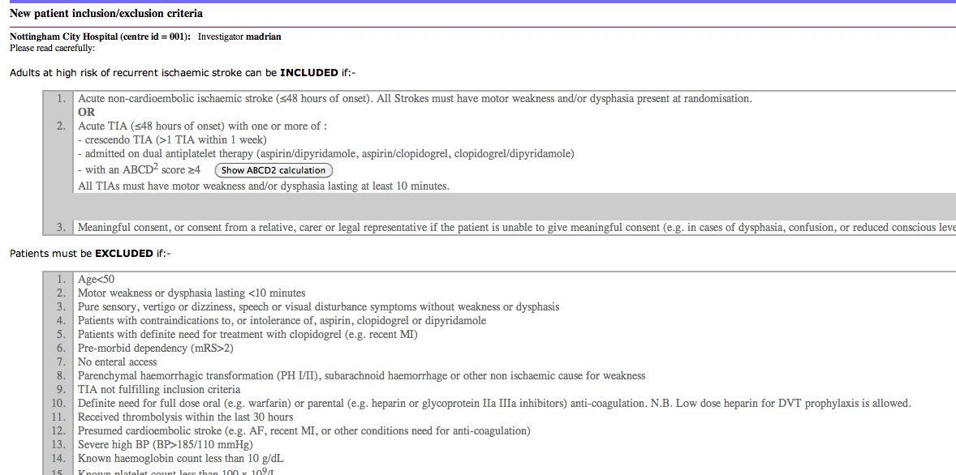
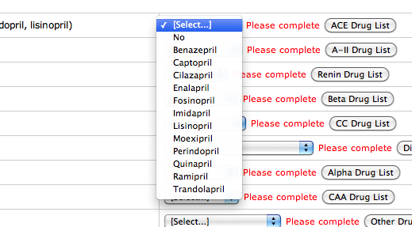
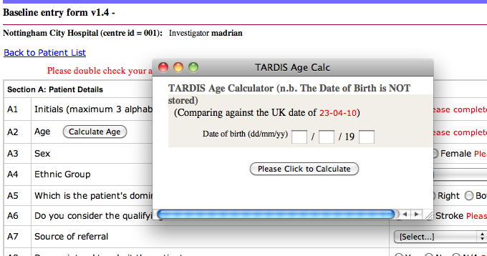
Help available on ‘live’ website
Inclusion/Exclusion criteria shown before
randomisation
Drop down boxes giving choices eg
  Ethnicity
  MRS
  CT result
  Y/N answers
Validation checks throw up red messages
    Lists (for information)
      Drugs
      ABCD2 score
      Lists (for information)
    Age Calculation
www.tardistrial.org

Slide 45
TARDIS: PAYMENTS
PLEASE DO NOT INVOICE US FOR RECRUITMENT OR TRAVEL EXPENSES
We automatically pay you for recruitment as per the contract (£50) once all required documentation has been received at the coordinating centre
You should pay for travel expenses i.e. mileage/taxis etc. and will be reimbursed once we receive proof of expenditure – please provide the information below (maximum of £50 per recruit).
Information required:
  Centre no …… (Cxxx)
  Recruit ID …… (xxxx)
  Initials …… (xxx)
  Visit No: Day 7 or 35
  Date of visit.
Proof of expenditure i.e. copy of taxi invoice or petty cash receipt signed by recruit
www.tardistrial.org

Slide 46
OTHER INFORMATION
Website: www.tardistrial.org
Within TARDIS Website at:
  http://www.tardistrial.org/jevpybki.htm
  Frequently Asked Questions (FAQs)
  Demo Website (demoinv1 nottingham 8888)
  Data Entry Forms
  Contact list
  Working Practice Documents (WPDs)
  Sponsor Standard Operating Procedures (SOPs)
Trials Office:
  Tel: 0115 823 1770 (plus answerphone)
  Fax: 0115 823 1771
www.tardistrial.org

Slide 47
TARDIS: Staff
Chief Investigator Philip Bath
Trial Manager Diane Havard
UK Trial Coordinators Margaret Adrian
Michael Stringer
Jamie Longmate
90 day Follow-up Joanne Keeling
James Kirby
Jenny Smithson
Medic Jason Appleton
Outcome/SAE adjud. Nikola Sprigg
Imaging adjudicator Rob Dineen
Statistician Lisa Woodhouse
Programmer Richard Dooley
Data/imaging Dawn Hazle
Secretary Yvonne Smallwood
P-selectin sub-study Sue Fox, Jane May
www.tardistrial.org

Slide 48
Thank you
Any further questions?
www.tardistrial.org

