Slide 1


INVESTIGATORS MEETING
14th & 15th September 2015
NEURO IMAGING
JASON APPLETON

Slide 2
Brain imaging
Role of CT and MRI scan
Issues from a practitioner’s perspective
Facts to remember
Slides and discussion
Some practical tips
Quiz
Questions

Slide 3
Issues
Are symptoms compatible with stroke?
Classification of stroke - ischaemic or haemorrhagic
Classification of stroke subtype
Associated complications – haemorrhagic transformation, mass effect or hydrocephalus
Aetiology- hyperdense MCA or white matter change

Slide 4
Facts to remember
Left sided lesions cause right sided symptoms and vice-versa except in cerebellar lesions
CT and MRI scans do not diagnose stroke - stroke is a clinical diagnosis
Neuroimaging is useful to determine ischaemia or haemorrhage
CT scan can be normal in acute ischaemia
CT scan can appear normal in very small lacunar strokes
Normal neuroimaging does not exclude stroke.

Slide 5
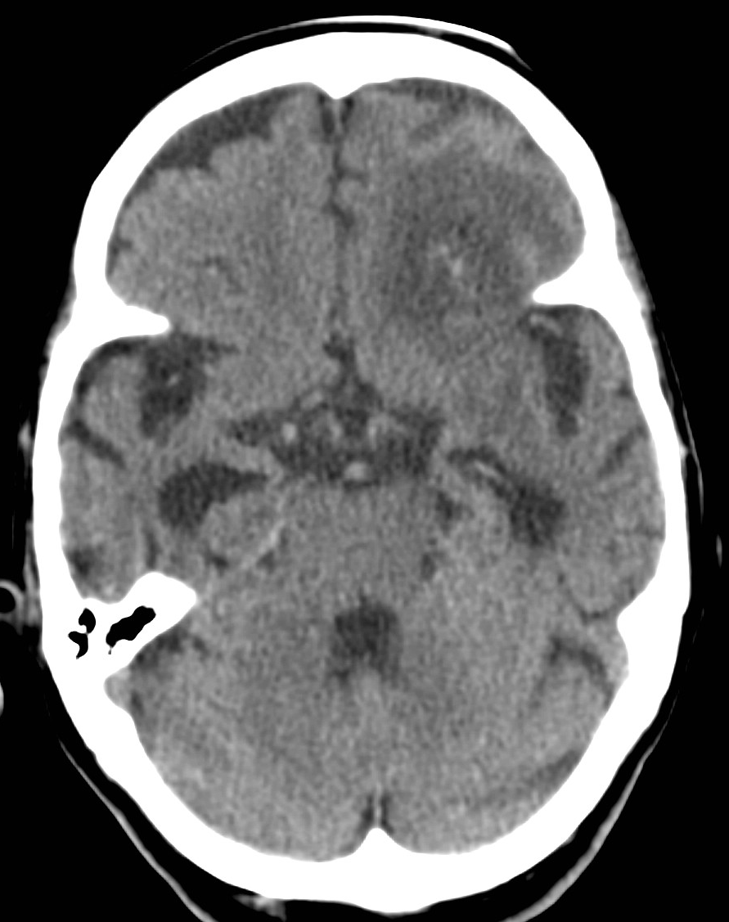
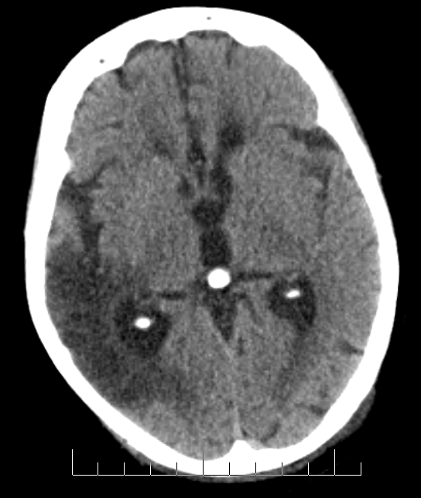
CT: Ischaemic stroke

Slide 6
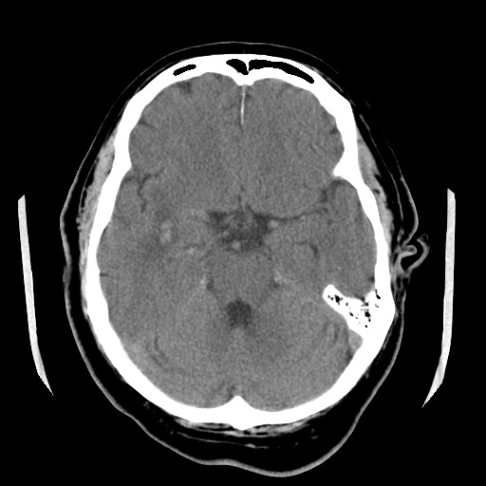
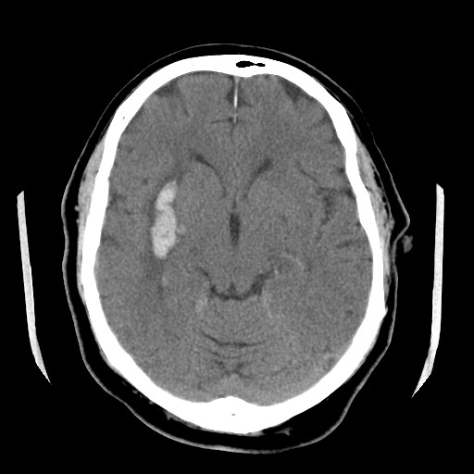
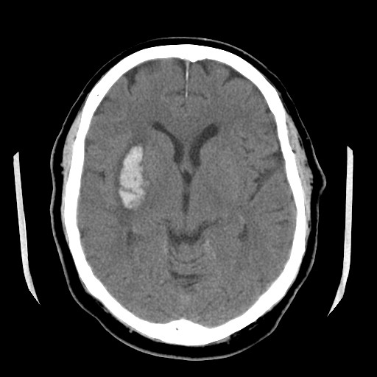
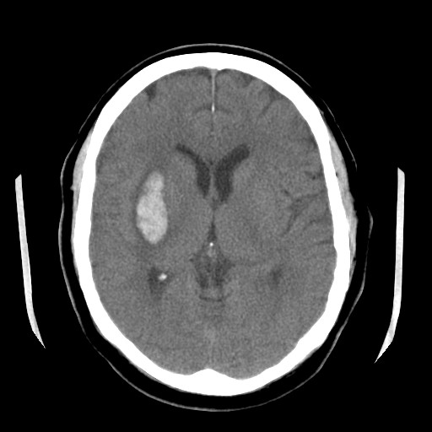
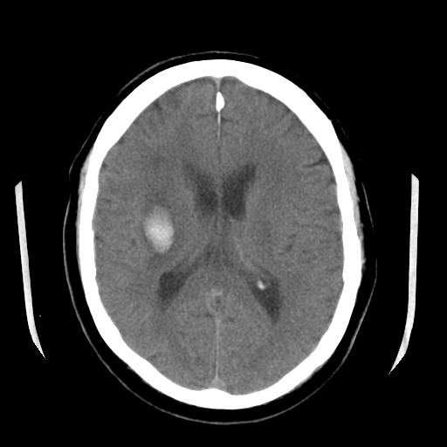
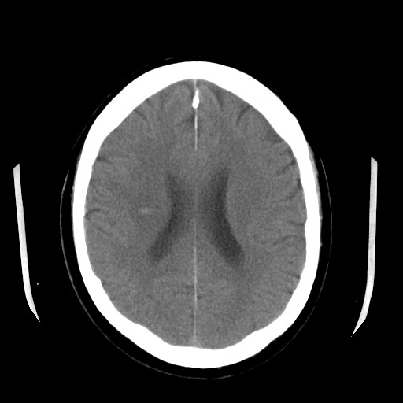
CT: Haemorrhagic stroke

Slide 7
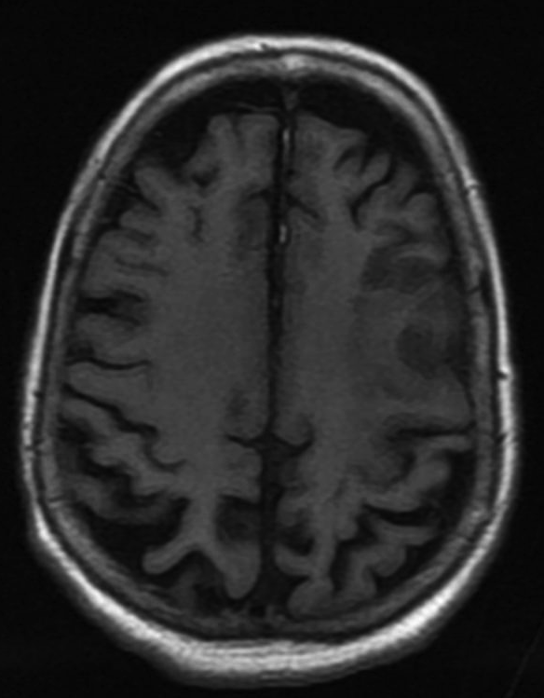
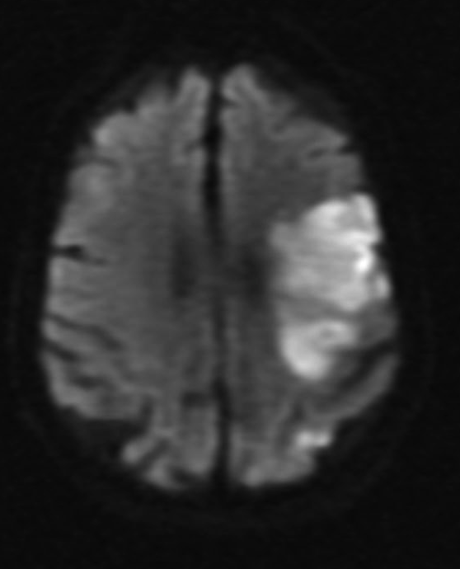
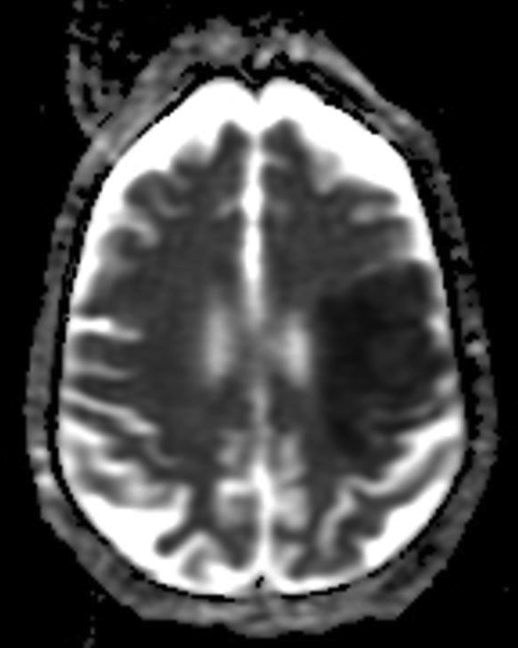
MRI: Ischaemic stroke
T1 DWI ADC

Slide 8
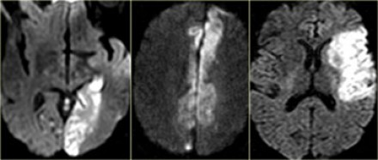
MRI: Ischaemic stroke

Slide 9
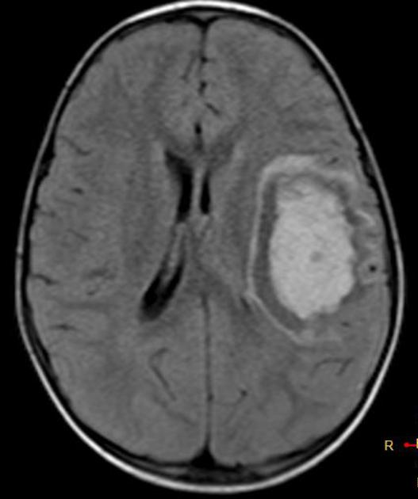
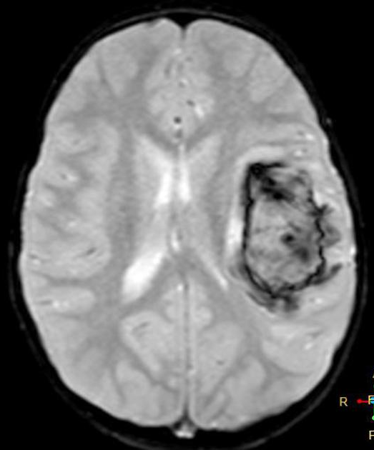
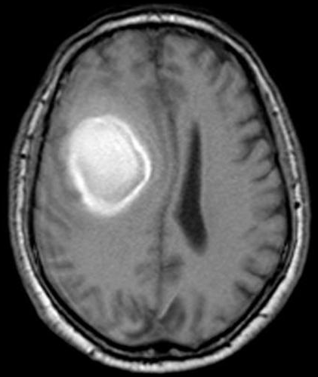
MRI: Haemorrhagic stroke

Slide 10
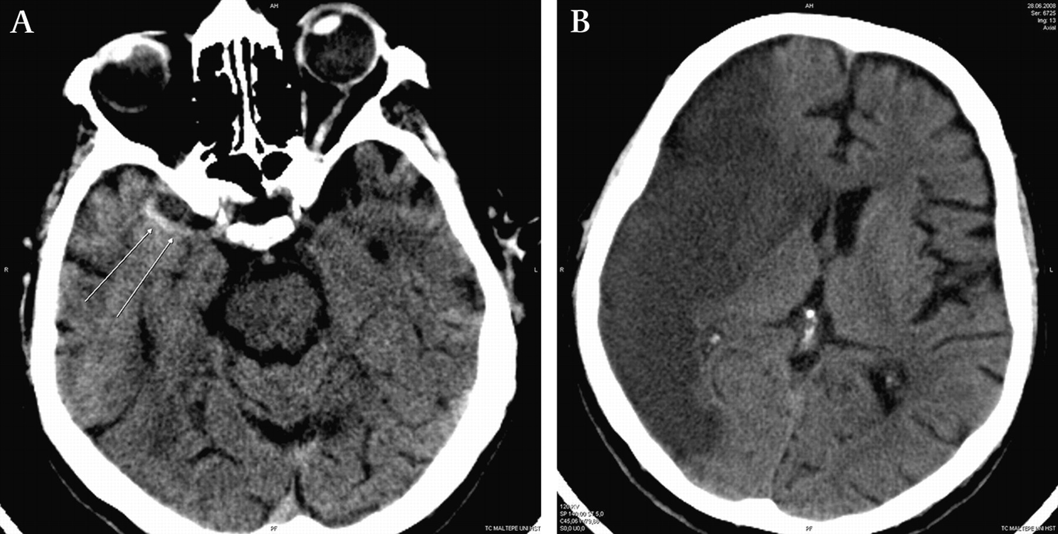
Classification of stroke: OCSP
Total Anterior Circulation Syndrome (TACS):
Motor and/or sensory, AND
Hemianopia, AND
Higher cerebral dysfunction
E.g. neglect, dysphasia, difficulty in performing complex tasks

Slide 11
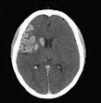
Classification of stroke: OCSP
Partial Anterior Circulation Syndrome (PACS):
Higher cerebral dysfunction (neglect, dysphasia)
+/- hemianopia
+/- motor and/or sensory
OR
Hemianopia + motor and/or sensory

Slide 12
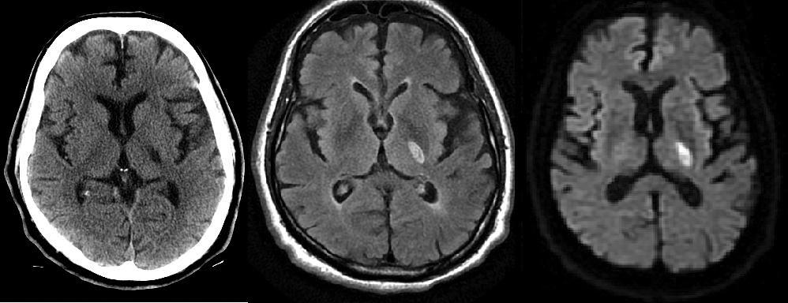
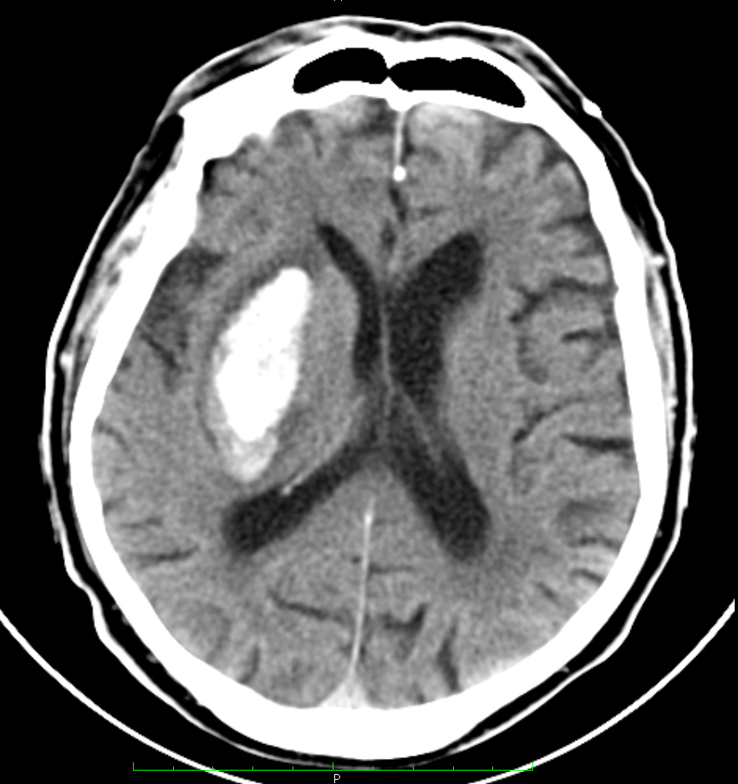
Classification of stroke: OCSP
Lacunar Syndrome (LACS):
Hemiparesis and/or sensory symptoms involving at least two regions of face, arm and/or leg
Usually subcortical location
No hemianopia or cortical features

Slide 13
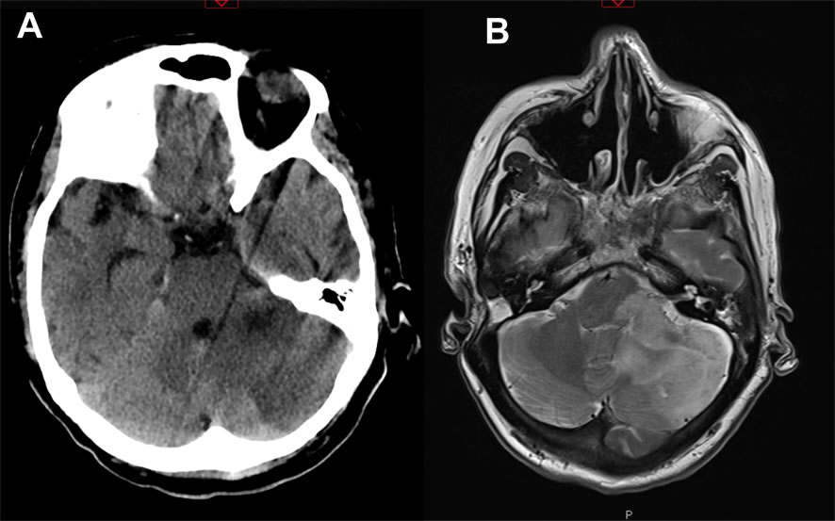
Classification of stroke: OCSP
Posterior Circulation Syndrome (POCS):
Problems in coordination, bilateral weakness, isolated field defect or loss of eye movement, impaired swallow

Slide 14
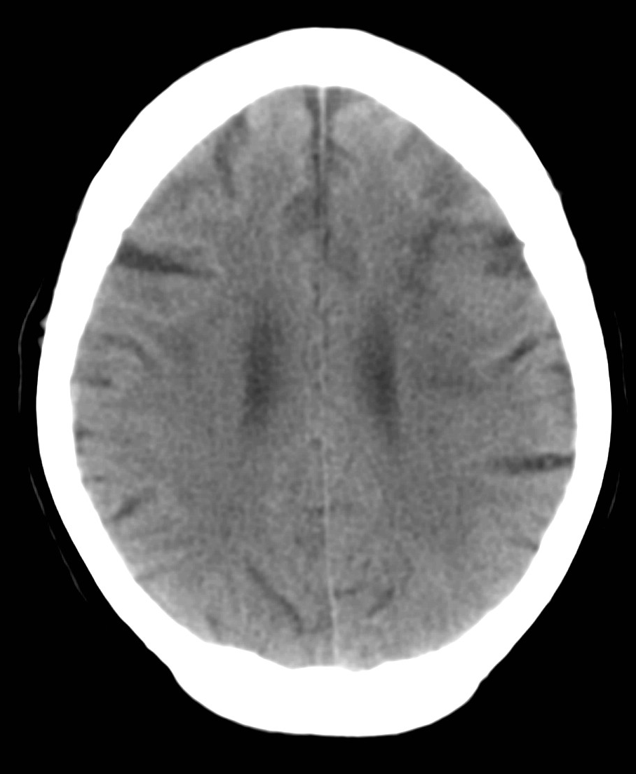
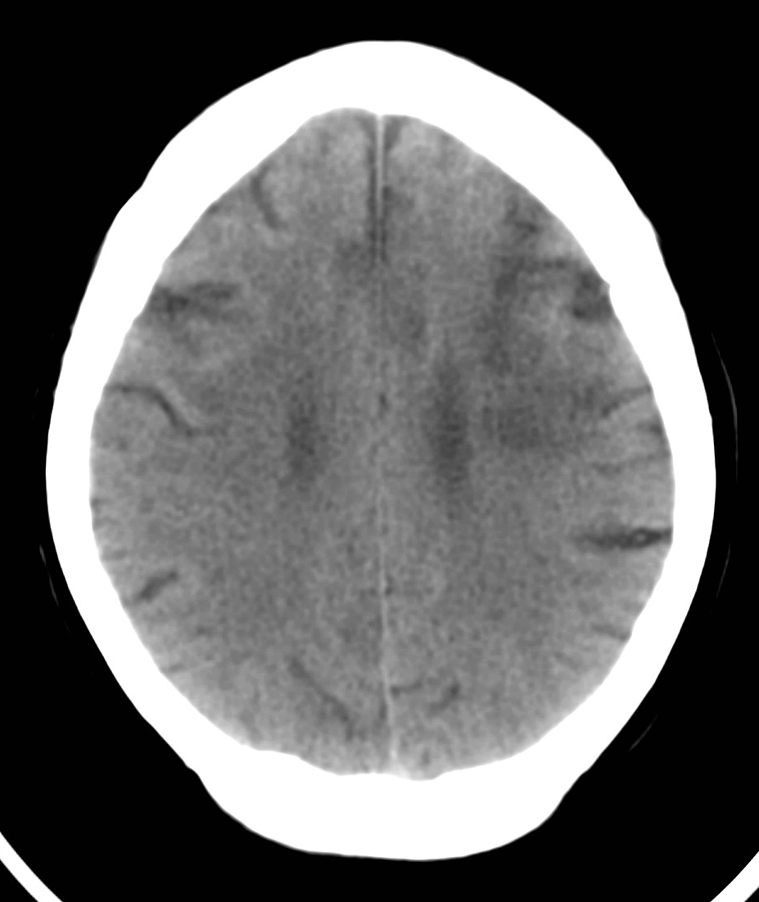
Evolution of infarcts
Day 1 Day 7

Slide 15
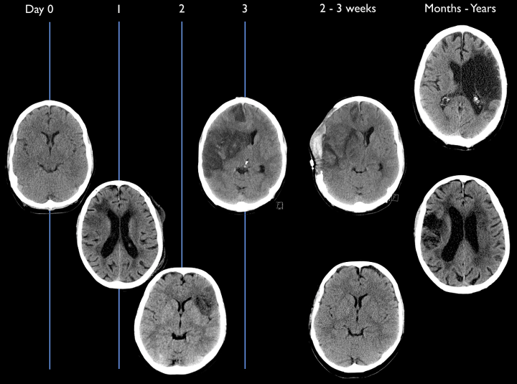
Evolution of infarcts

Slide 16
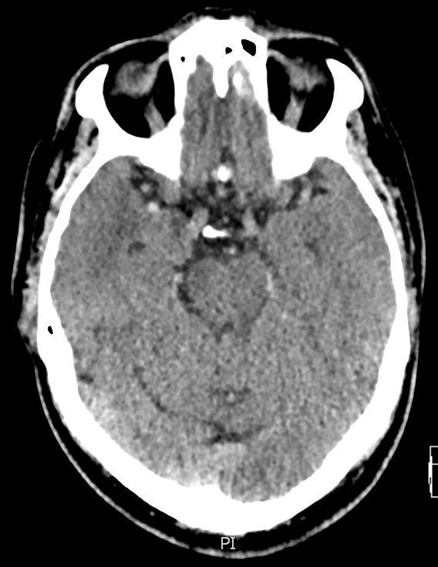

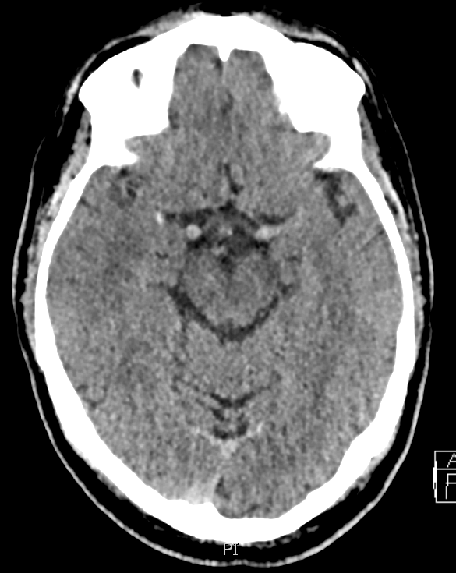
CT scan image
Hyperdense MCA

Slide 17
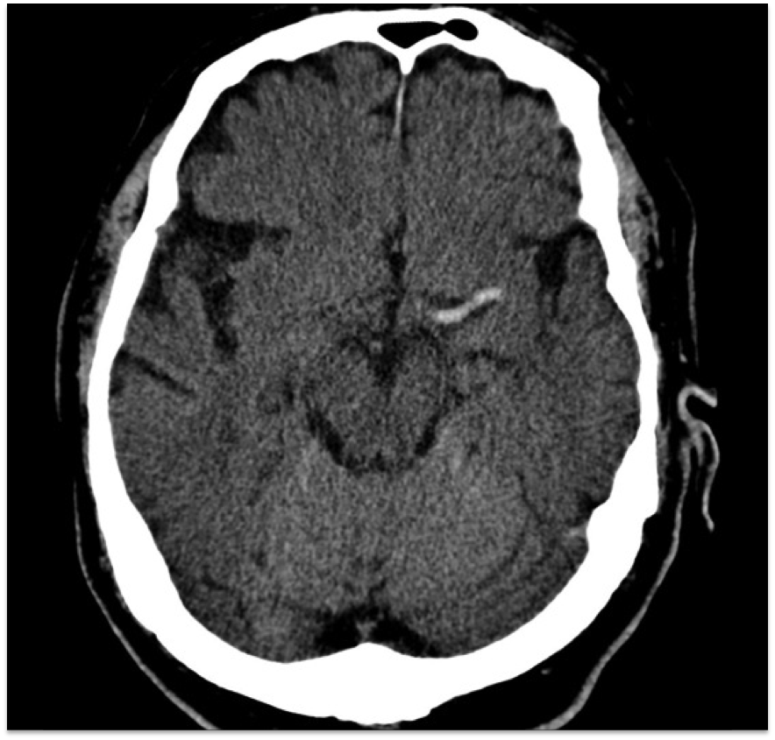
CT scan image
Hyperdense MCA

Slide 18
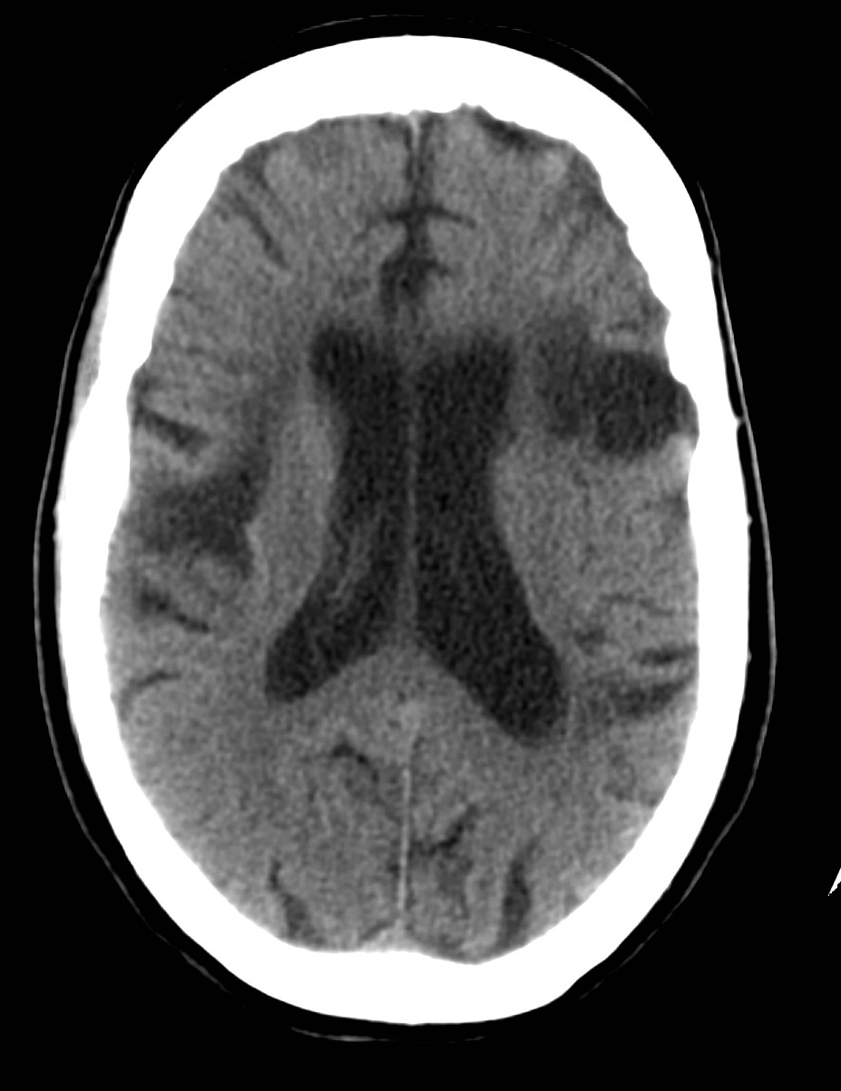
Types of infarct
Chronic
Haemorrhagic transformation

Slide 19
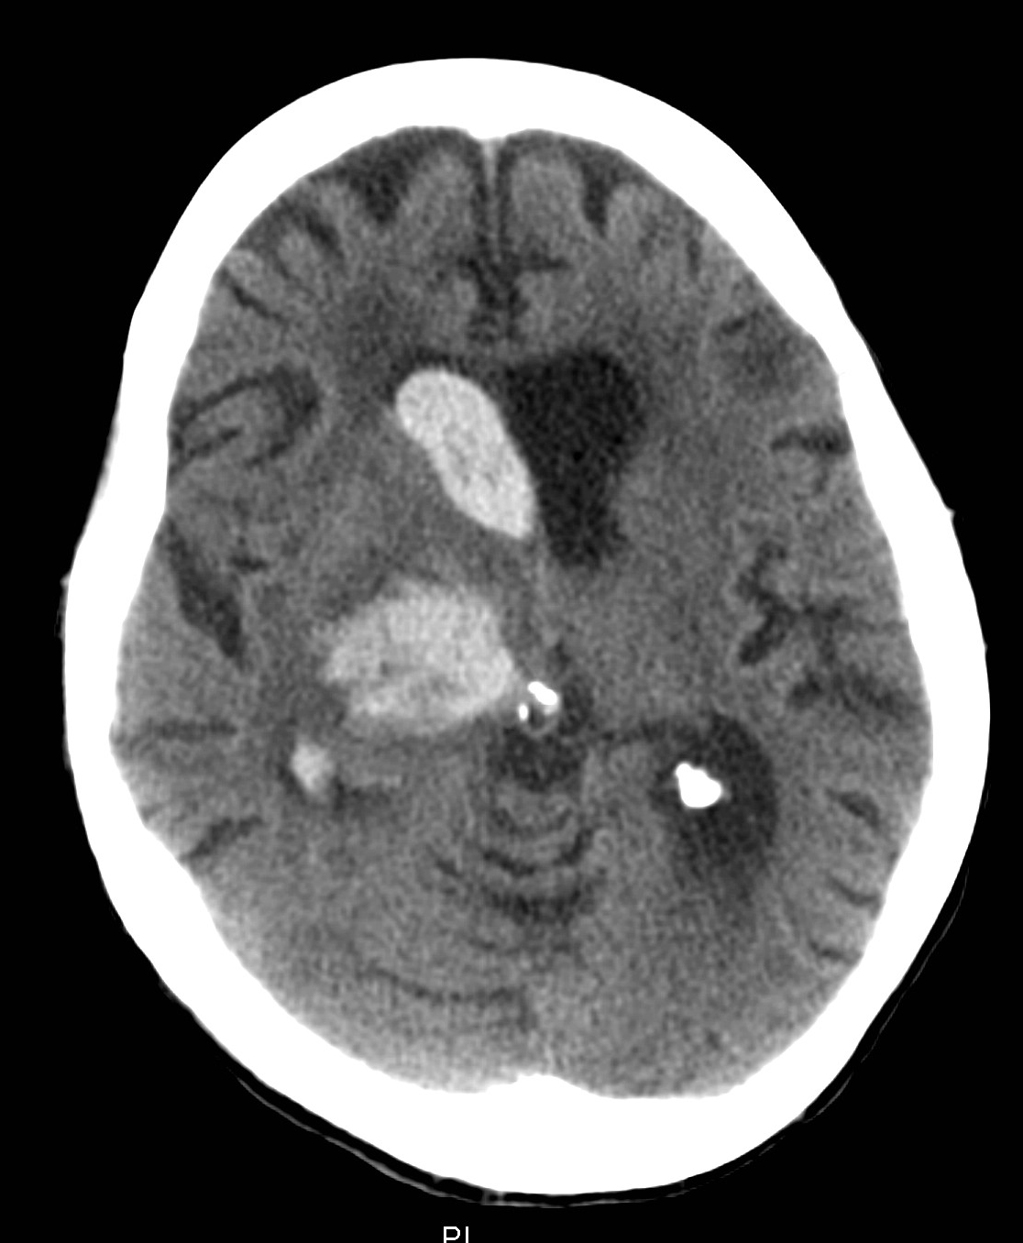
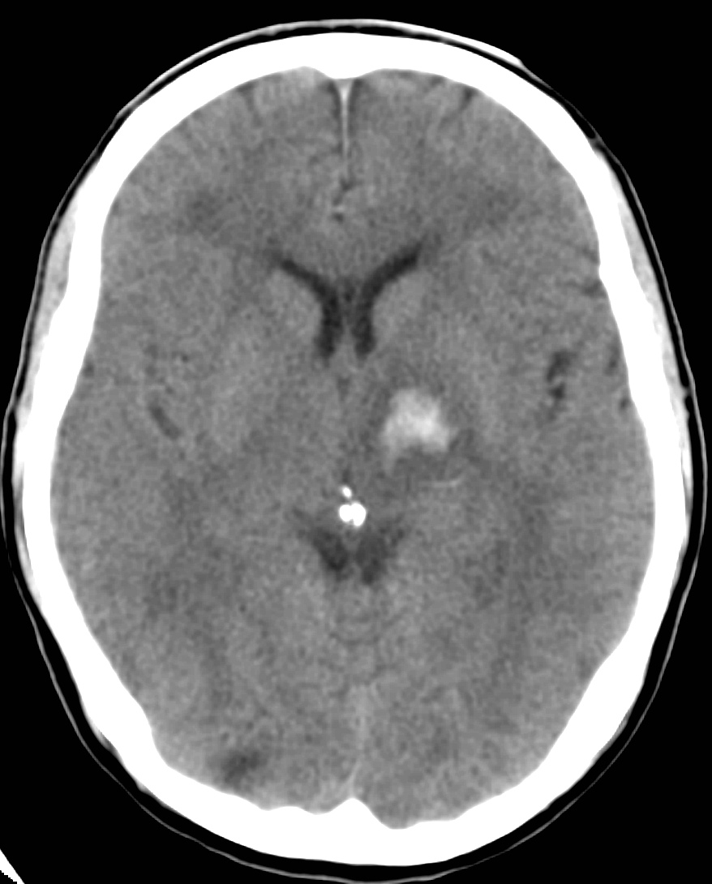
Intracranial Haemorrhage

Slide 20
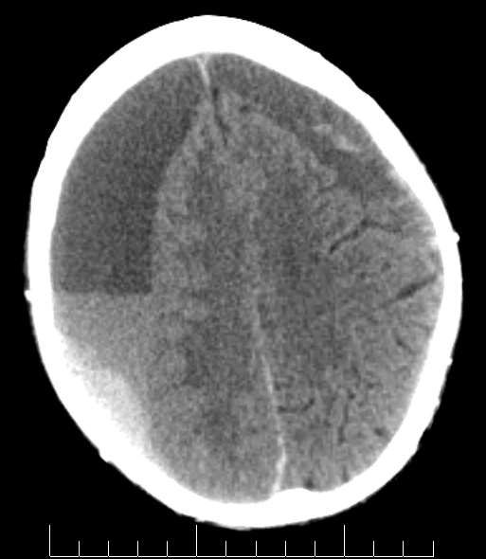
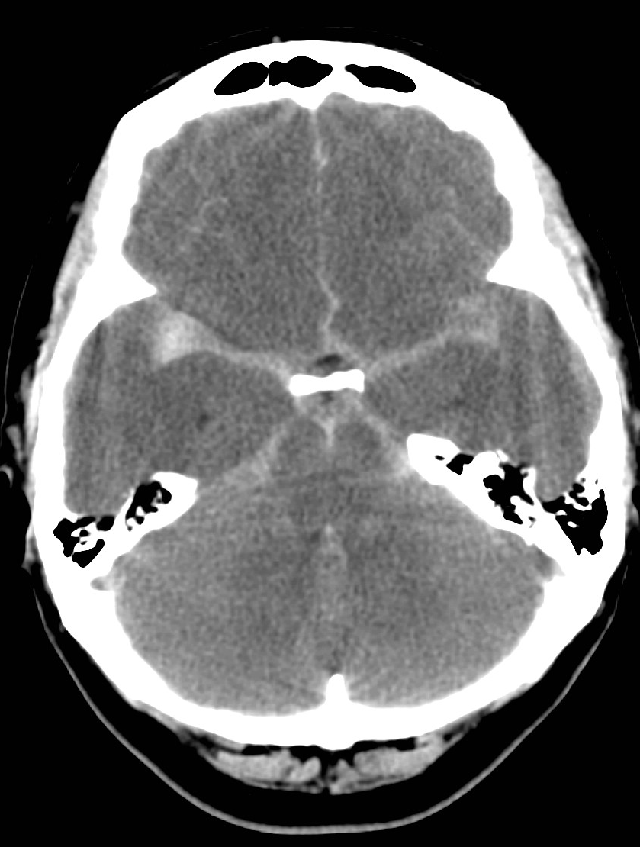
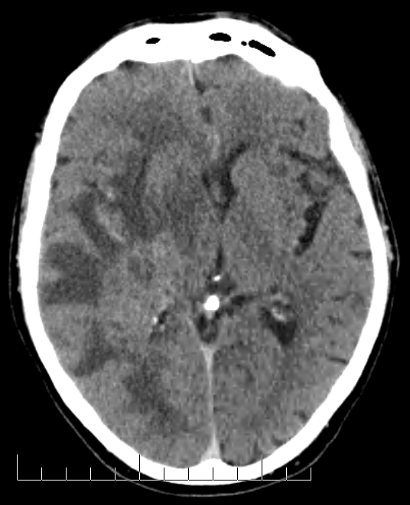
Other causes of neurological symptoms
Subdural Haematoma
Subarachnoid Haemorrhage
Glioblastoma Multiforme

Slide 21
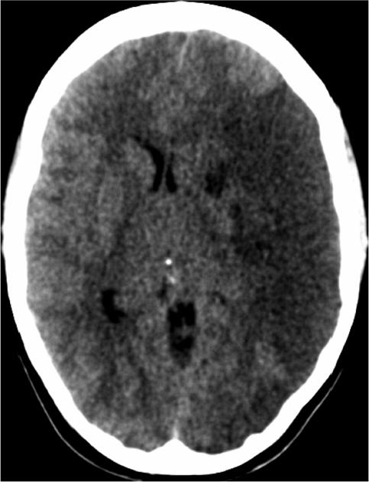
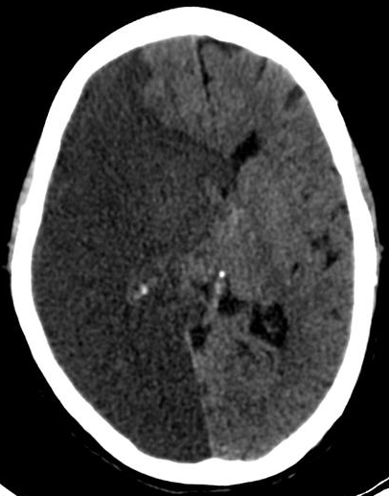
Complications after stroke
Mass effect

Slide 22
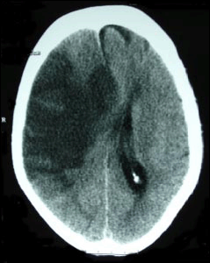
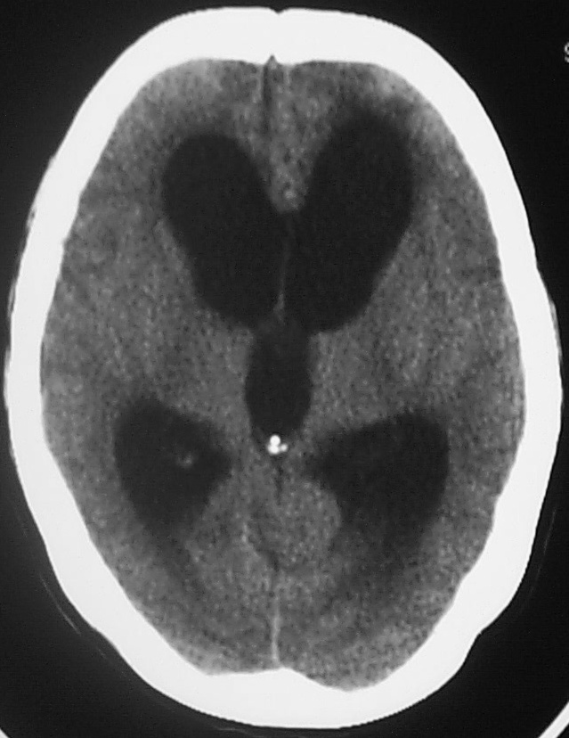
Mass effect vs. hydrocephalus

Slide 23
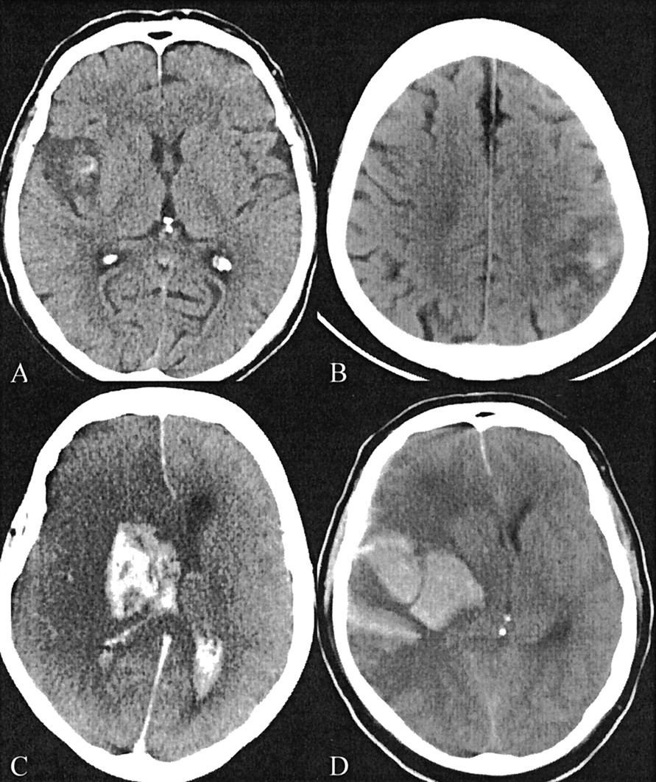
Haemorrhagic transformation of Infarct (HTI)

Slide 24
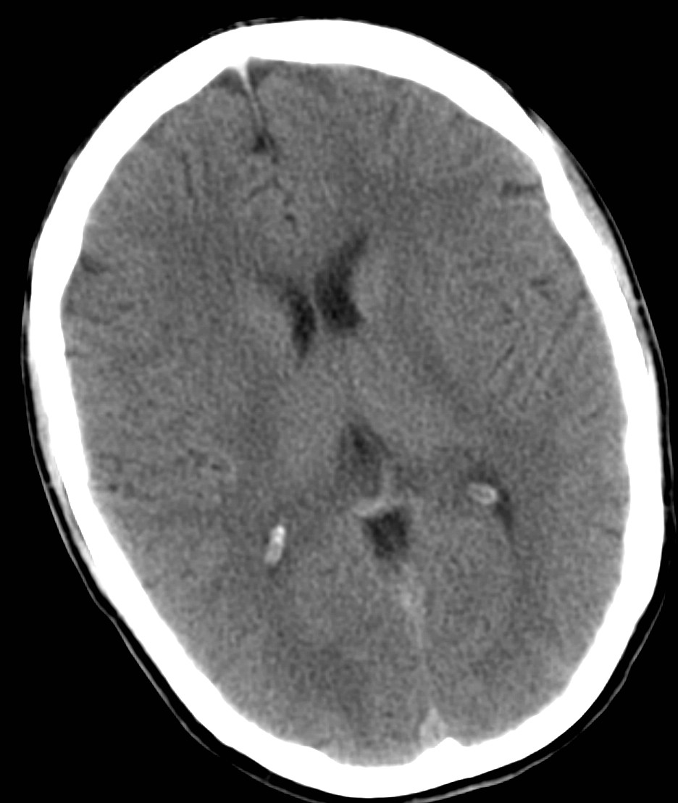
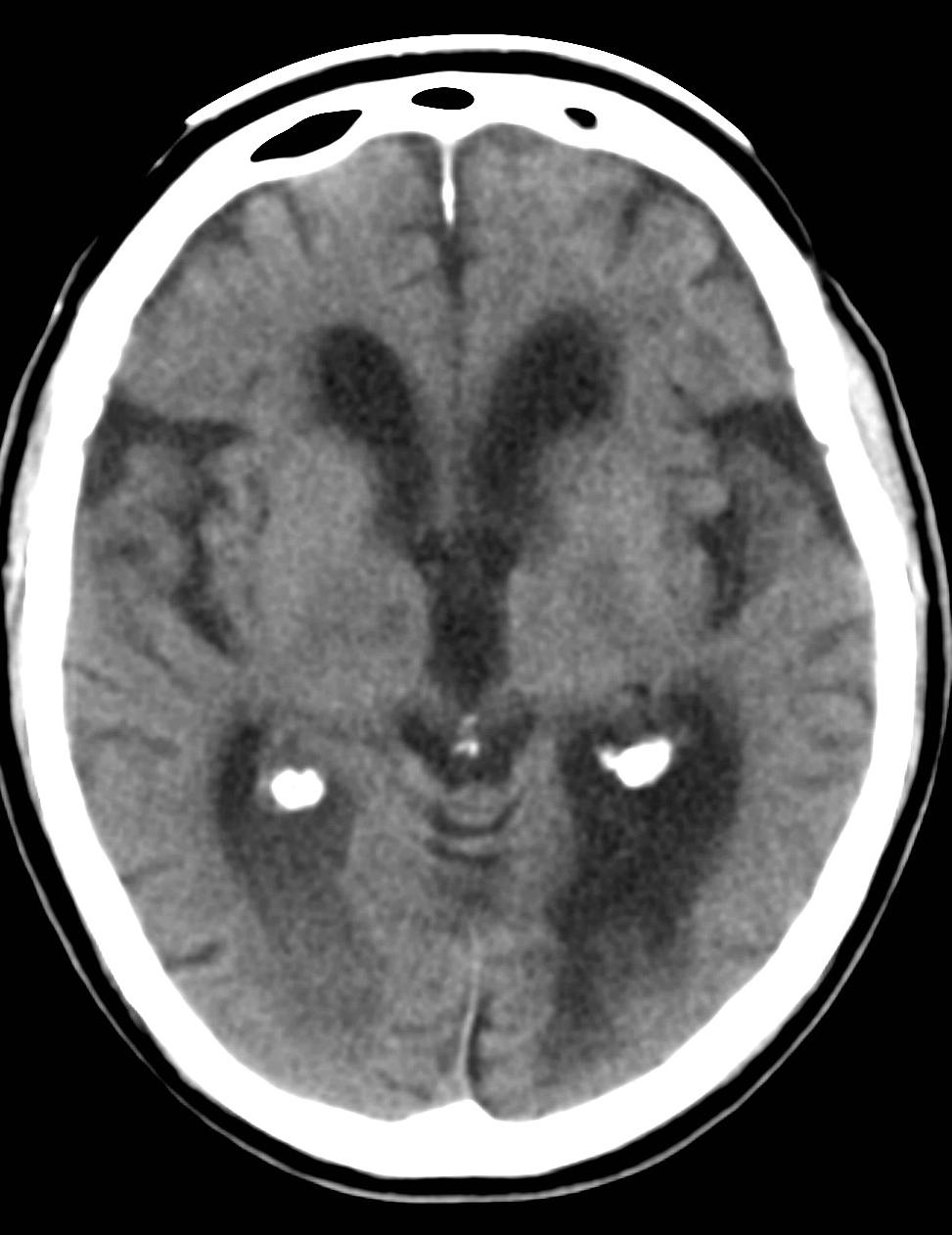
Cerebral atrophy

Slide 25
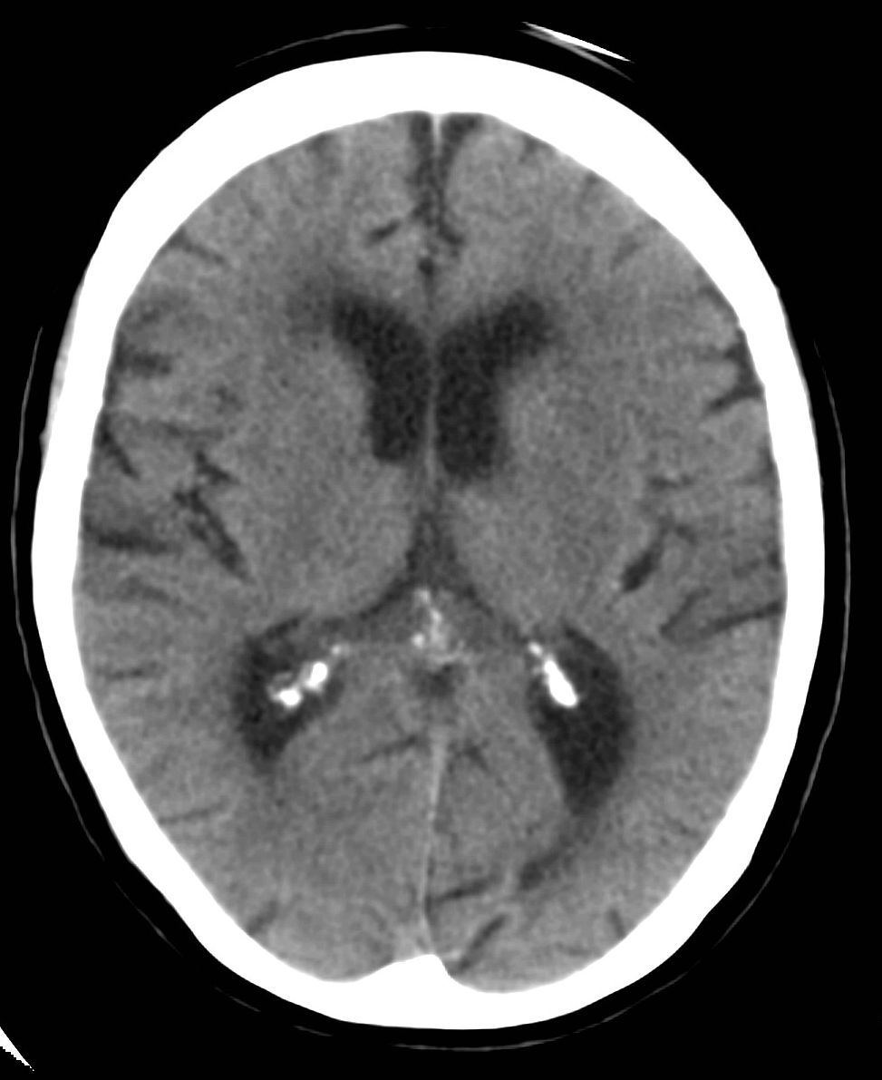
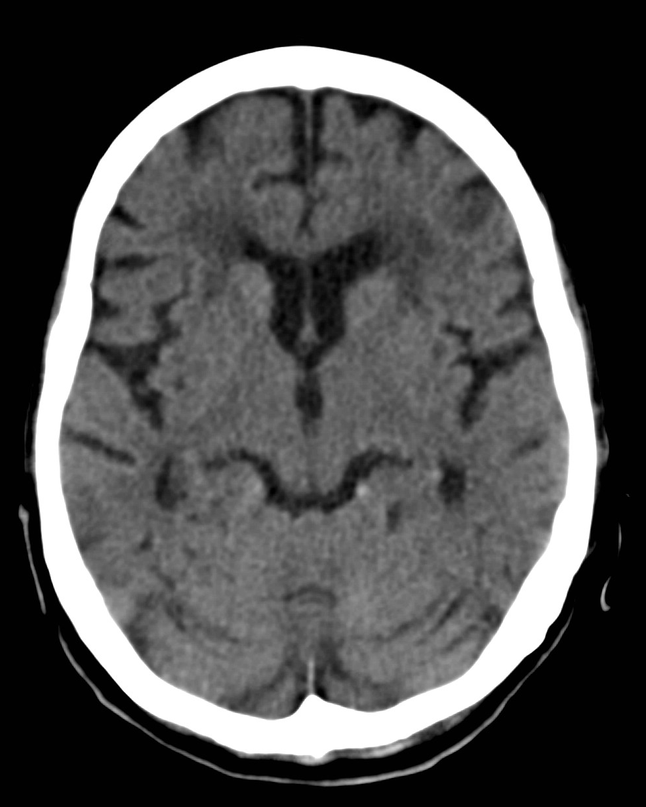
Periventricular white matter change
Mild
Moderate

Slide 26
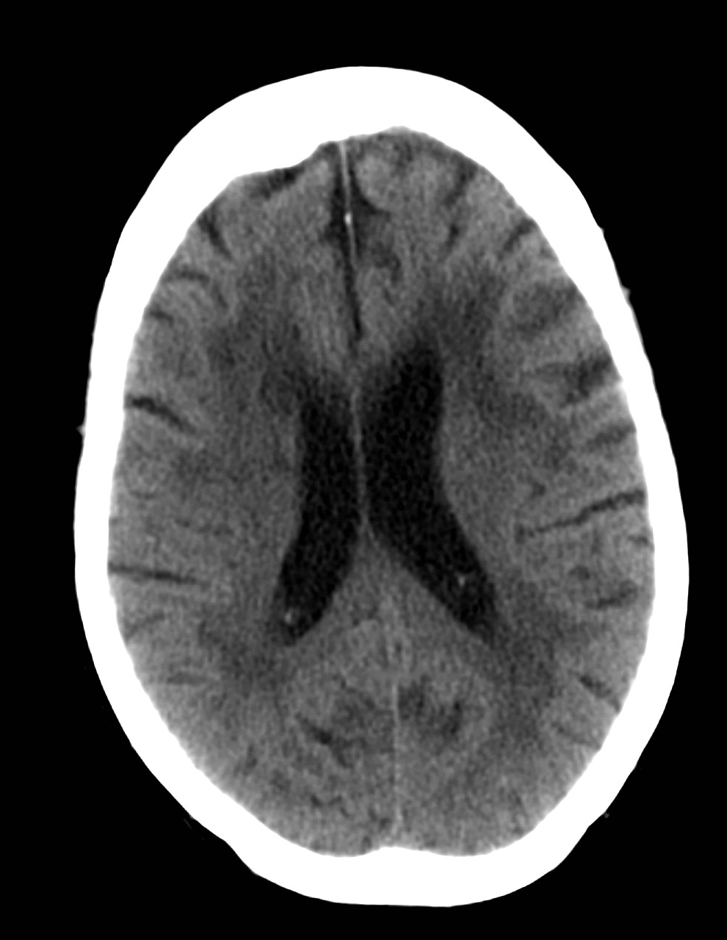
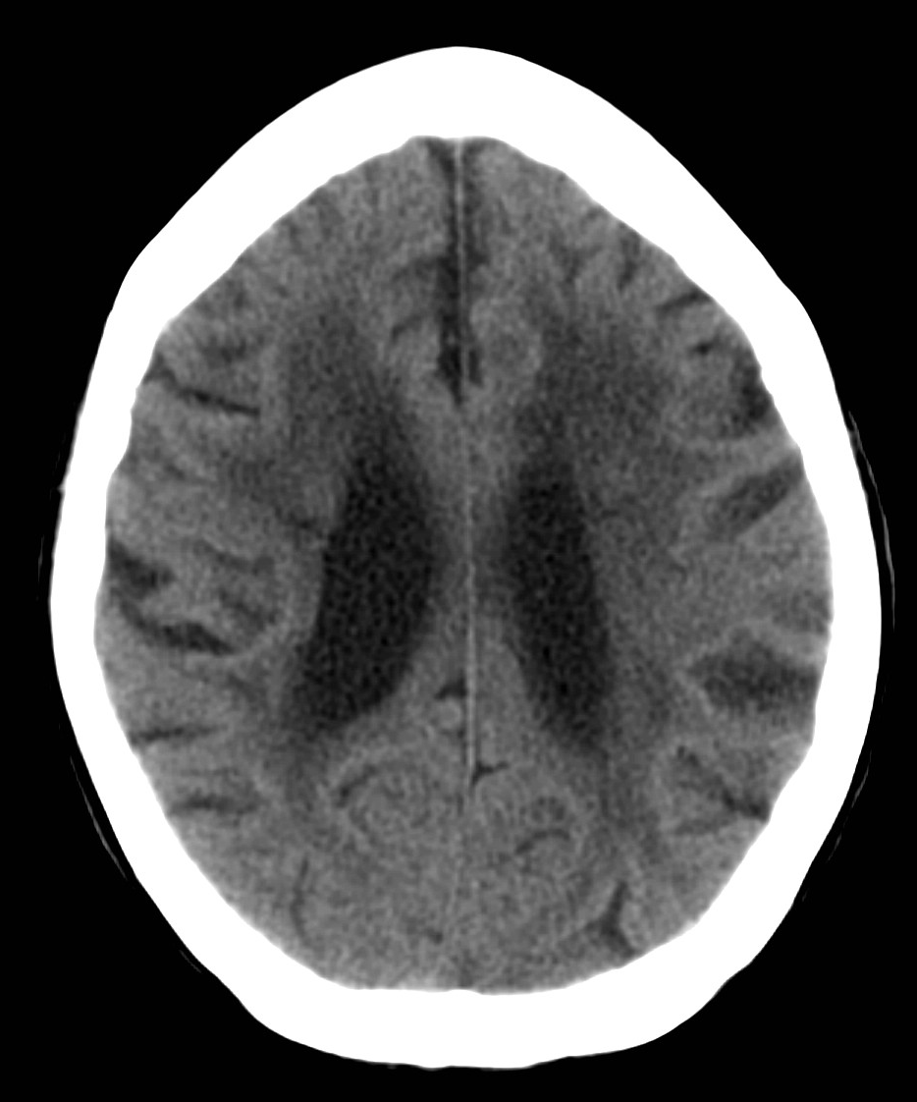
Periventricular white matter change

Slide 27
Reports: Infarct
Choose infarct related to the current presentation if:
‘Hypodensity’, ‘ infarct’, ‘infarction’ with ‘acute’, ‘subacute’, ‘patchy’, ‘subtle’ or occasionally no other description
Do not choose infarct if:
‘Old’, ‘mature’ along with infarct or ‘hypodensity’

Slide 28
Reports: Infarct
Do not choose infarct if infarct with descriptions like:
‘haemorrhage’, ‘haemorrhagic transformation’, ‘bleeding’, ‘blood’

Slide 29
Reports: Haemorrhage
Choose haemorrhage if:
‘primary intracerebral haemorrhage’, ‘blood’, ‘haemorrhage’.
There are several causes of ICH:
PICH, SDH, EDH, SAH and tumour.
These are likely to be mentioned in the report and sometimes may need further imaging to detect the cause
Do not choose ‘Haemorrhagic transformation’ as it means infarct

Slide 30
Reports: Haemorrhagic transformation
Choose if:
‘haemorrhagic transformation or infarct+’ ‘blood’, ‘haemorrhage’, ‘bleeding in the infarct’.
Choose ‘No lesion seen’ if:
‘normal’ or ‘no intracranial abnormalities’

Slide 31
Practical tips: Interpreting reports
‘mass effect’
‘atrophy’
‘evidence of white matter change’
‘old stroke’

Slide 32
Practical tips: Interpreting reports
Mass effect
Choose yes for mass effect if: ‘mass effect’, ‘midline shift’, ‘ventricular effacement’
If it says these are not present or there is no mention of the above, choose no.
NB: hydrocephalus is NOT mass effect

Slide 33
Practical tips: Interpreting reports
Atrophy
Choose yes if ‘atrophy’ or ‘involutional change’
If no mention or ‘age appropriate’ and the patient age less than 60 choose no.

Slide 34
Practical tips: Interpreting reports
Periventricular white matter lucency
Choose yes if:
‘periventricular white matter lucency’, ‘leukoaraiosis’, ‘white matter disease’, ‘white matter change’, ‘small vessel disease’, ‘small vessel ischaemia’.
If the report says these are absent or not mentioned answer no

Slide 35
Practical tips: Interpreting reports
Previous stroke
Choose yes if ‘old’ or ‘mature infarcts’
If they are not mentioned, or noted to be absent answer no.

Slide 36
Practical tips: Interpreting reports
Most important of all:
If you don’t understand the scan report, please ask a doctor.
The more you do and the more you ask, more familiarity with the terminology!

Slide 37
Quiz
Case 1:
78 year old patient with right sided weakness and aphasia.
CT report: There is extensive infarction affecting the entire MCA territory on the left with a hyperdense MCA. There is associated midline shift. There is some high intensity change within the infarction, suggestive of petechial bleeding’.

Slide 38
Quiz
Case 2:
62 year old patient with right hemiparesis, hemisensory loss and headache.
CT report: There is a small, localised area of haemorrhage within the thalamus on the left side. No mass effect, no oedema. Extensive involutional change is noted.

Slide 39
Quiz
Case 3:
70 year old patient with sudden onset right sided weakness.
CT report: There is evidence of multiple well-established old infarctions in both cerebral hemispheres. There is an area of hypodensity in the region of the left internal capsule which may represent more recent ischaemia. There is extensive leukoaraiosis and atrophy.

Slide 40
Quiz
Case 4:
80 year old patient with left arm weakness
CT report: No intracranial abnormality

Slide 41
Neuroimaging
Any questions?

Slide 42
References
Images:
Radiopedia.org
www.radiologyassistant.nl/en/p483910a4b6f14/brain-ischemia-imaging-in-acute-stroke.html

