Slide 1
On-site monitoring and common problems found
Margaret Adrian
Senior UK Trial Co-ordinator
Notes:
1

Slide 2
Site monitoring
Coordinating Centre is responsible for monitoring its trials
Different types
  initial checks when we receive the documents (consent, patient details, drug chart, radiology reports etc)
  background data checks, validation (range, consistency, no missing data), review of recruitment rates, withdrawals and losses to follow-up
  on-site monitoring

Slide 3
On-site monitoring
Provides the opportunity to:
Educate staff about the trial
  Understand the protocol and trial procedures
  Clarification of any misunderstandings
Verify that site staff have access to the necessary documents to conduct the trial
Confirm that pharmacy and laboratory resources are in place
Check adherence to the protocol and GCP
Verify selected data and SAEs recorded in CRFs as compared with data in clinical records
  To identify errors of omission as well as inaccuracies
Confirm that written consent was obtained correctly
Confirm that the patient exists

Slide 4
TICH-2 / TARDIS
  Unable to corroborate, as missing from medical notes mainly :
    NIHSS
    GCS
    Blood pressure/pulse
If done at the time and entered directly onto the e/CRF – it also needs entering in the medical notes, for corroboration and informing the clinical team caring for the patient.
Many sites have a stroke pro-forma for NIHSS and add days 2 and 7 to this for TICH-2.

Slide 5
    Cannot corroborate the following from the medical notes as not filed – maybe electronic records
    Blood results
    Radiology reports
    Drug charts
    Print, anonymise and keep a copy in participant trial file for monitoring/audit purposes.

Slide 6
Missing:
  Retention of notes stickers on medical notes.
    Some using own stickers instead.
    We have recently updated our TICH-2 stickers to include trial id and contact no.
  Times loading doses of antiplatelets given in TARDIS.
    If not admitted – write on prescription/drug chart (should be seen to take the loading doses therefore times should be known. This includes first dose of dipyridamole).
  Both trials. SAEs missing from ISF
    signed/dated by PI to confirm agreement of data entered.

Slide 7
Faxed information
  Apart from the consent form/patient details form and GP letter, everything should be anonymised by replacing all patient identifying information with the full recruit trial id, i.e. C999/9999/ZZZ, prior to sending to Co-ordinating Centre
  C999 is centre number
  9999 is recruit number
  ZZZ is recruit initials

Slide 8
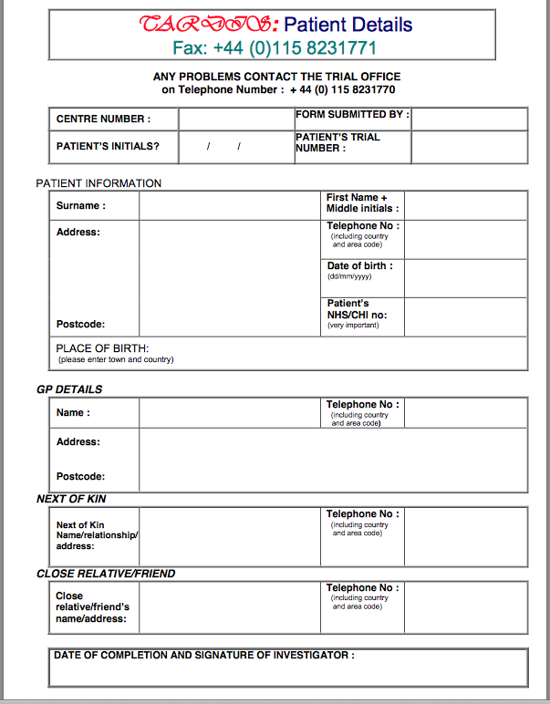
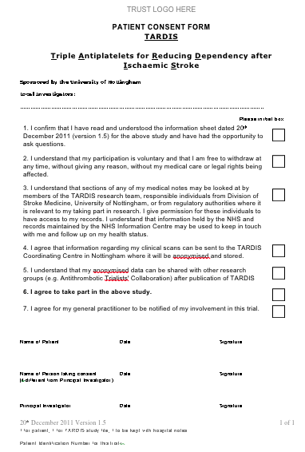
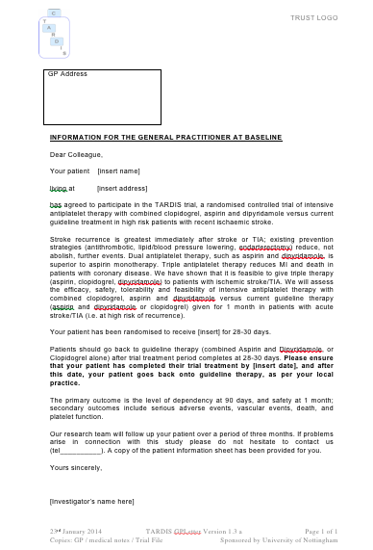
Unanonymised and anonymised paperwork needs to be kept separately.
Patient Details
Consent Form/s
GP letters

Slide 9
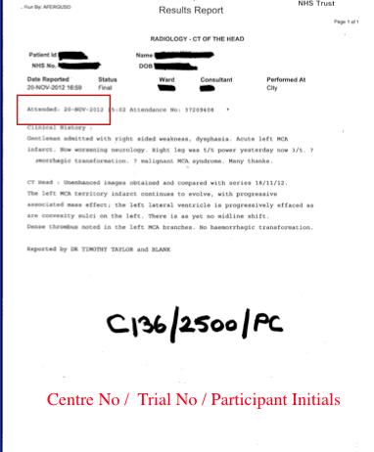
Date of investigation is date attended (usually radiology scans)
NOT date reported
Full trial ID to replace name, dob, NHS

Slide 10
Missing:
  GP letters, (or undated)
  Information sheets
  Copies of both to be filed in medical notes and ISF
  Info sheets can go in participant trial file instead of ISF.

Slide 11
Eligibility of patient for the particular trial not always clear from the medical notes. Contradicting information found.
  (TARDIS) When entering in medical notes regarding randomisation of patient, information on eligibility is helpful - specific symptoms for the randomising event and whether they have resolved or still ongoing at time of randomisation. (duration of dysphasia/weakness particularly important)
  Record in medical notes any new information obtained directly from patient/relatives, if the only place it is recorded is on the CRF

Slide 12
Limited or no written entries in medical records for trial follow-up appointments:
TARDIS – Days 7 and 35
    NIHSS - 2 x BP and pulse readings which must be done at the time of the visit. Also any other changes to relevant medications, patient health status, new events, side effects, whether trial medications being taken etc.
TICH-2 – Days 2 and 7
  NIHSS & GCS

Slide 13
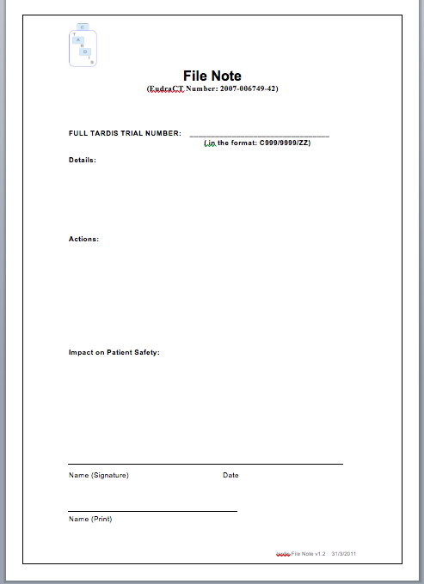
Missing documents from ISF if filed elsewhere
or documents not kept up-to-date from website
Centre C099-Hospital Name
Investigator Site File
Section 8 – CVs and GCP certificates for all investigators are filed in the red file marked ‘CV/GCPs’ kept in the Research Room, Floor A – filing cabinet X
    Use filenotes

Slide 14
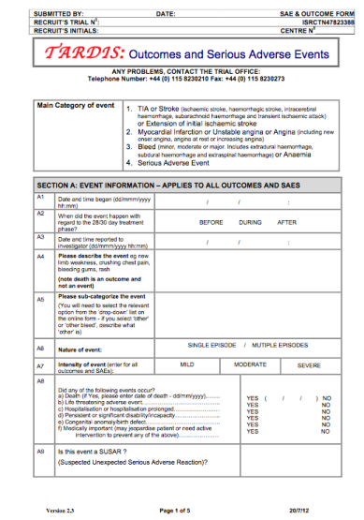
Failure to report SAEs
TICH-2
  Seizures need reporting, even if they were an existing condition, prior to randomising event.
  Remember all SAEs/SARs/SUSARS up to Day 7, thereafter only SUSARS, fatal SAEs and safety outcomes.
TARDIS
  All up to Day 90 completion (incl any bleed).

Slide 15
If still using paper CRFs then they need to be fully completed and match the data entered on the website.
Must be dated and signed by the investigator who completes the form.
Headers need to be completed (see below)

Slide 16
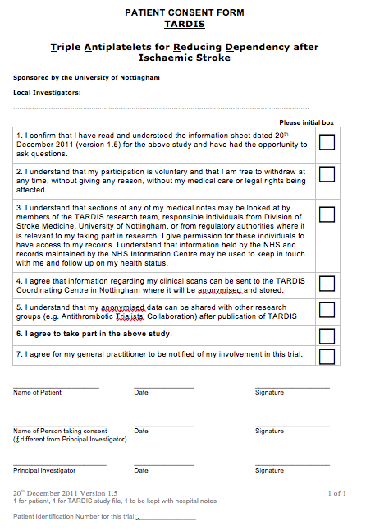
Consent forms incorrectly completed
  Patient initials in boxes
  Do not use
  Person consenting must be authorised on delegation log
Dr V Grainger, PI
AJ
AJ
AJ
AJ
AJ
✔
AJ
AJ
Andrew James
26/1/13
AJAMES
Dr Havers
26/1/13
LHavers
C154/1250/AJ

Slide 17
NEW INVESTIGATORS
Prior to any new investigators working on the trial we require the following documents:
Delegation log
  authorised by PI (showing delegated duties)
Signed/dated CV
  showing latest GCP training + contact details (preferably use the 1-page SRN layout)
Up to date GCP certificate
TARDIS paper training log - Once paperwork checked access will be given for TARDIS.
TICH-2 investigators are given access to allow online assessment to be completed.

Slide 18
On-site monitoring & common problems found
Any questions?

